Slide 1



Statistical Analysis and Learning (SAL): What is Statistical Learning? (ISL Ch2) Textbook: An Introduction to Statistical Learning (ISL)
Varun Rai
LBJ School of Public Affairs
The University of Texas at Austin
24th January 2018

Slide 2
Note on Material
Unless otherwise noted, all material in this presentation are from this course’s textbook, An Introduction to Statistical Learning (ISL)

Slide 3
What is Statistical Learning?
Statistical learning refers to a vast set of tools for understanding data. These tools can be classified as supervised or unsupervised.
Supervised statistical learning involves building a statistical model for predicting, or estimating, an output based on one or more inputs. Problems of this nature occur in fields as diverse as business, medicine, astrophysics, and public policy.
With unsupervised statistical learning, there are inputs but no supervising output; nevertheless we can learn relationships and structure from such data.

Slide 4
Regression vs. Classification
Regression: quantitative response variable
Classification: qualitative response variable
But the distinction is not always clear. For example, logistic regression can be thought of both as a classification and a regression approach
It estimates the probability of a unit belonging to a certain class.
We tend to select statistical learning methods on the basis of whether the response is quantitative or qualitative; i.e. we might use linear regression when quantitative and logistic regression when qualitative. However, whether the predictors are qualitative or quantitative is generally considered less important. Most of the statistical learning methods discussed in this course can be applied regardless of the predictor variable type, provided that any qualitative predictors are properly coded before the analysis is performed (next class).

Slide 5
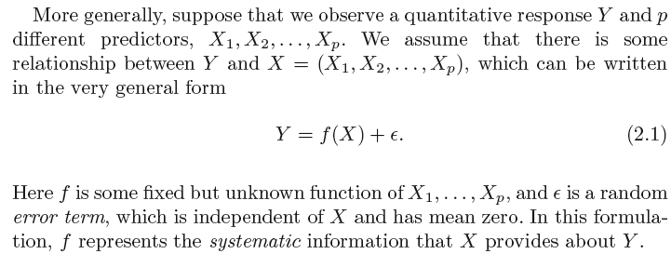
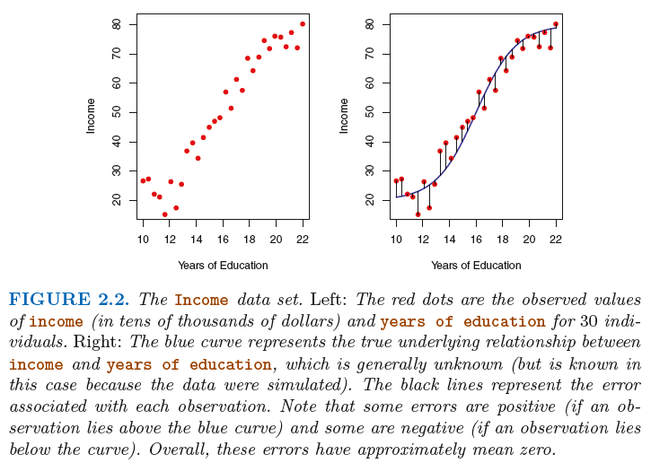
Quantitative Response Y and its p predictors

Slide 6
Why Estimate f?
Inference: direction and/or magnitude of predictors influence on the outcome variable is of interest
Does human activity cause climate change?
Will administering drug X increase chances of survival in a patient?
Other examples?
Prediction: only the value of the outcome variable is of interest
How much rainfall will California have in 2050?
How much solar photovoltaic (PV) will be installed in the U.S. in 2016?
Other examples?
Some times both are of interest, but often only one (inference or prediction) is of primary interest
The primary objective of the analyst has a huge bearing on the selection of methods for statistical learning.

Slide 7
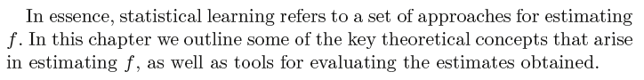
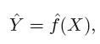
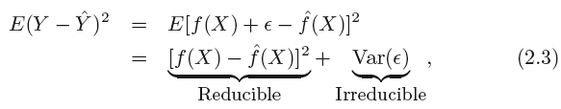
Why Estimate f? Prediction
The focus of this course is on techniques for estimating f with the aim of minimizing the reducible error. It is important to keep in mind that the irreducible error will always provide an upper bound on the accuracy of our prediction for Y. This bound is almost always unknown in practice.

Slide 8
Example of a Prediction Problem
Consider a company that is interested in conducting a direct-marketing campaign. The goal is to identify individuals who will respond positively to a mailing, based on observations of demographic variables measured on each individual.
In this case, the demographic variables serve as predictors, and response to the marketing campaign (either positive or negative) serves as the outcome.
The company is not interested in obtaining a deep understanding of the relationships between each individual predictor and the response; instead, the company simply wants an accurate model to predict the response using the predictors. This is an example of modeling for prediction.
Notes:
Prediction: consider a company that is interested in conducting a
direct-marketing campaign. The goal is to identify individuals who will
respond positively to a mailing, based on observations of demographic variables
measured on each individual. In this case, the demographic variables
serve as predictors, and response to the marketing campaign (either positive
or negative) serves as the outcome. The company is not interested
in obtaining a deep understanding of the relationships between each individual
predictor and the response; instead, the company simply wants
an accurate model to predict the response using the predictors. This is an
example of modeling for prediction.

Slide 9
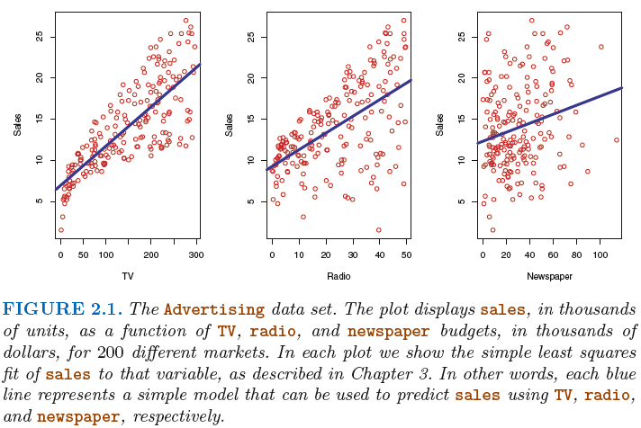
Examples of an Inference Problem
One may be interested in answering questions such as:
– Which media contribute to sales?
– Which media generate the biggest boost in sales? or
– How much increase in sales is associated with a given increase in TV advertising?

Slide 10
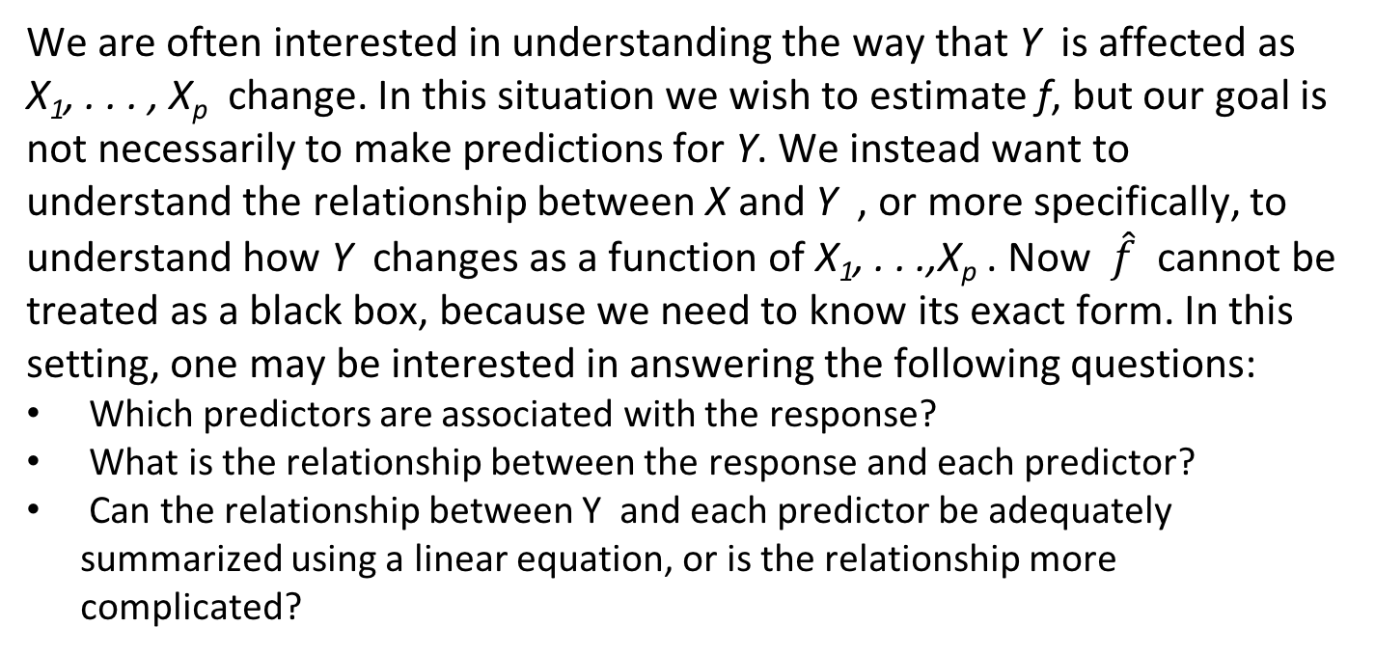
Why Estimate f? Inference
We are often interested in understanding the way that Y is affected as X₁, . . . , X_{p} change. In this situation we wish to estimate f, but our goal is not necessarily to make predictions for Y. We instead want to understand the relationship between X and Y , or more specifically, to understand how Y changes as a function of X₁, . . .,X_{p} . Now $\hat{f}$ cannot be treated as a black box, because we need to know its exact form. In this setting, one may be interested in answering the following questions:
Which predictors are associated with the response?
What is the relationship between the response and each predictor?
Can the relationship between Y and each predictor be adequately summarized using a linear equation, or is the relationship more complicated?

Slide 11
Inference vs. Prediction/Interpretability vs. Accuracy
Depending on whether our ultimate goal is prediction, inference, or a combination of the two, different methods for estimating f may be appropriate. For example, linear models allow for relatively simple and interpretable inference, but may not yield as accurate predictions as some other approaches.
In contrast, some of the highly non-linear approaches that we will discuss later in this course can potentially provide quite accurate predictions for Y, but this comes at the expense of a less interpretable model for which inference is more challenging.

Slide 12
How Do We Estimate f ?

Slide 13
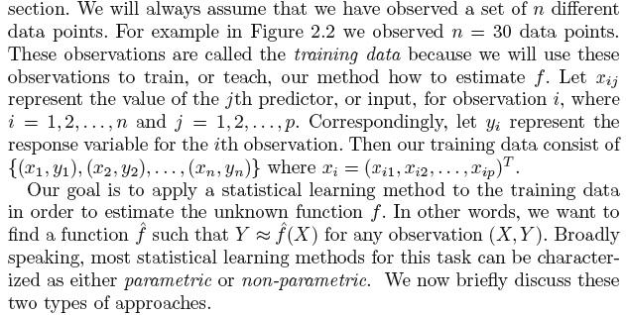
How Do We Estimate f?
Linear and non-linear models
Parametric vs. Non-parametric approaches

Slide 14
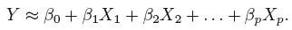
How Do We Estimate f? Parametric Approach
Two-step process
Step 1: Assume functional form for f. For example, a very simple assumption is that f is linear in X:
Step 2: Estimate the parameters/coefficients using a fitting procedure (say, least squares) on training data:
parametric because it reduces the problem of estimating f down to one of estimating a set of parameters.

Slide 15
How Do We Estimate f? Parametric Approach
Assuming a parametric form for f simplifies the problem of estimating f because it is generally much easier to estimate a set of parameters, such as β₀, β₁, . . . , β_{p} in the linear model (2.4), than it is to fit an entirely arbitrary function f.
The potential disadvantage of a parametric approach is that the model we choose will usually not match the true unknown form of f. If the chosen model is too far from the true f , then our estimate will be poor.
We can try to address this problem by choosing flexible models that can fit many different possible functional forms flexible for f.
But in general, fitting a more flexible model requires estimating a greater number of parameters. These more complex models can lead to a phenomenon known as overfitting the data, which essentially means they overfitting follow the errors, or noise , too closely.

Slide 16
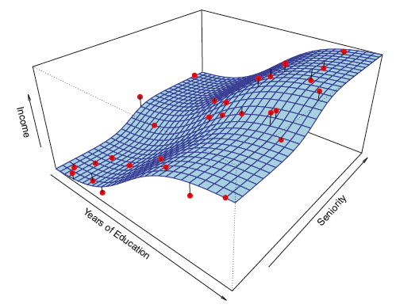
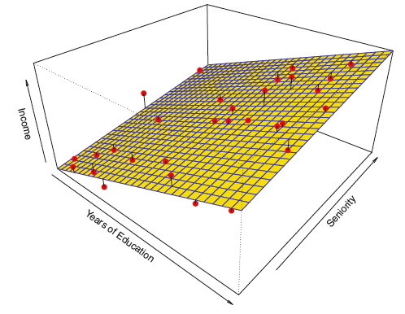
Simple Parametric Model

Slide 17
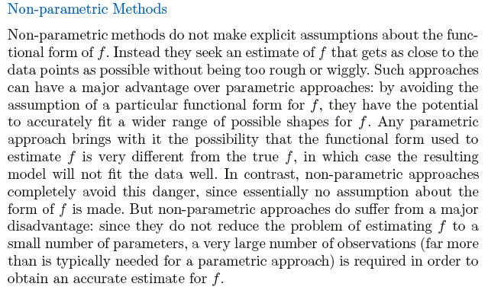
How Do We Estimate f? Non-Parametric Approach
Notes:
Non-parametric methods do not make explicit assumptions about the functional
form of f . Instead they seek an estimate of f that gets as close to the
data points as possible without being too rough or wiggly. Such approaches
can have a major advantage over parametric approaches: by avoiding the
assumption of a particular functional form for f , they have the potential
to accurately fit a wider range of possible shapes for f . Any parametric
approach brings with it the possibility that the functional form used to
estimate f is very different from the true f , in which case the resulting
model will not fit the data well. In contrast, non-parametric approaches
completely avoid this danger, since essentially no assumption about the
form of f is made. But non-parametric approaches do suffer from a major
disadvantage: since they do not reduce the problem of estimating f to a
small number of parameters, a very large number of observations (far more
than is typically needed for a parametric approach) is required in order to
obtain an accurate estimate for f .

Slide 18
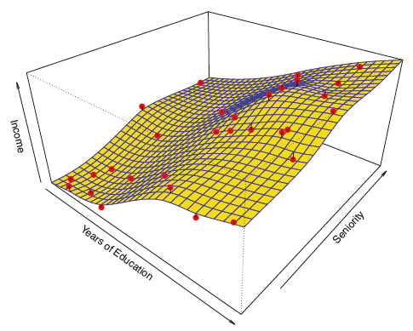
Non-Parametric Approach
A thin-plate spline is used to estimate f . This approach does not impose any pre-specified model on f. It instead attempts spline to produce an estimate for f that is as close as possible to the observed data, subject to the fit being smooth.
In order to fit a thin-plate spline, the data analyst must select a level of smoothness.
Notes:
thin-plate spline

Slide 19
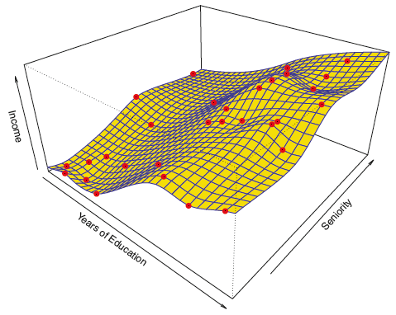
What Happens if Smoothness is Lowered?
Notes:
thin-plate spline

Slide 20
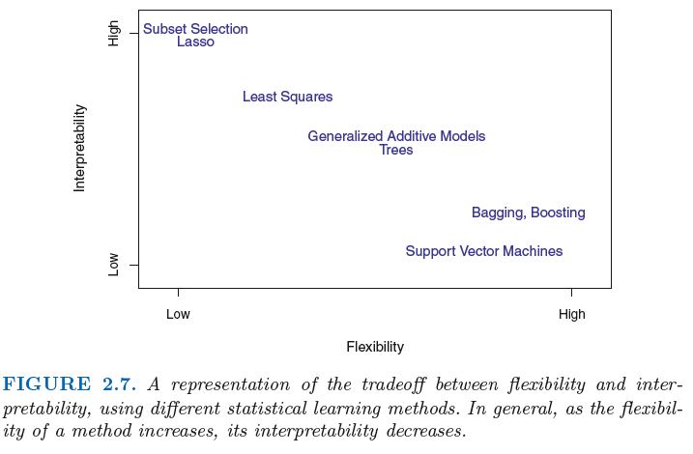
Trade-off Between Prediction Accuracy and Model Interpretability

Slide 21
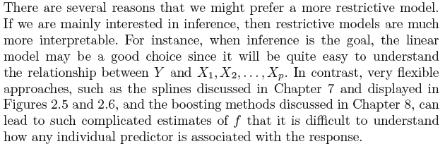
Why would we ever choose to use a more restrictive method instead of a very flexible approach?
So we should always choose a more complex (i.e., flexible) approach when prediction is the objective?

Slide 22
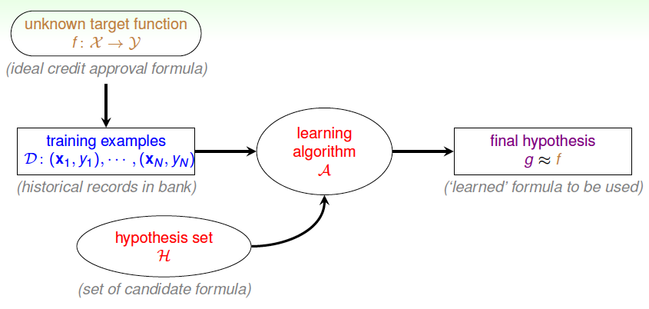
The Process of Learning
Source: Learning From Data, 2012.

Slide 23
Measuring the Quality of Fit With four parameters I can fit an elephant, and with five I can make him wiggle his trunk – John von Neumann

Slide 24
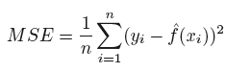
Mean Squared Error (MSE)

Slide 25
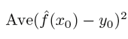
Training MSE vs. Test MSE
Training MSE: MSE on the sample used to fit the model
But often the interest is (should be?) in knowing how the model performs outside the sample that was used to fit
Analogy: Practice exam vs. Real final exam
Test data (x₀,y₀)
Test MSE (for many test observations):
Notes:
y_i is the observed value and f_hat is the estimated value.

Slide 26
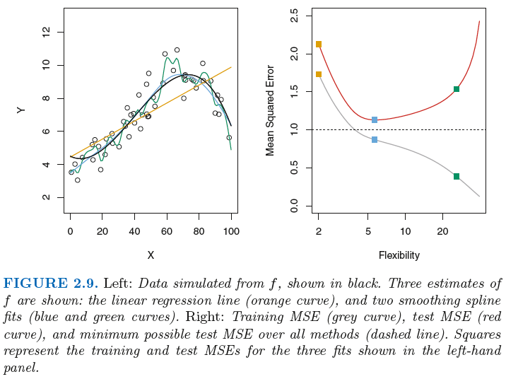
Training MSE vs. Test MSE

Slide 27
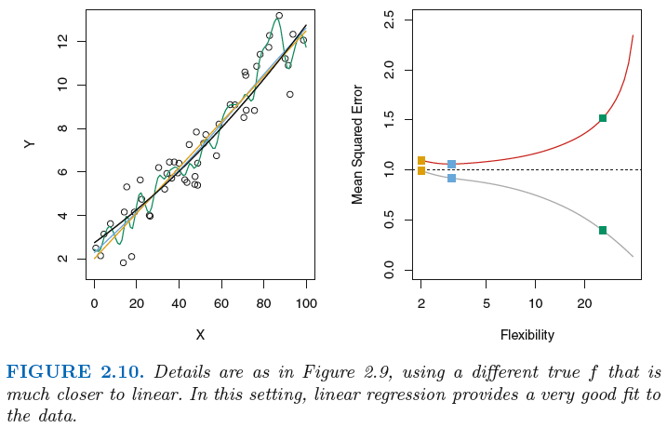
Training MSE vs. Test MSE

Slide 28
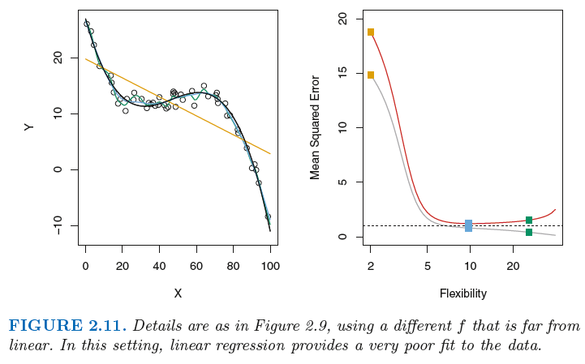
Training MSE vs. Test MSE

Slide 29
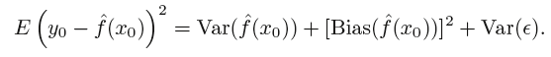
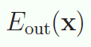
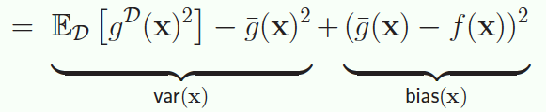
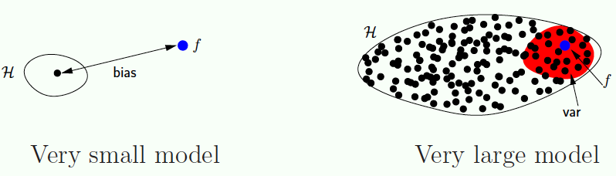
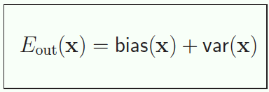
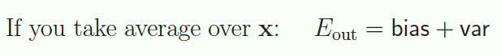
Bias-Variance Trade-off
Source: Learning From Data, 2012.

Slide 30
Bias-Variance Trade-off
Source: http://scott.fortmann-roe.com/docs/BiasVariance.html

Slide 31
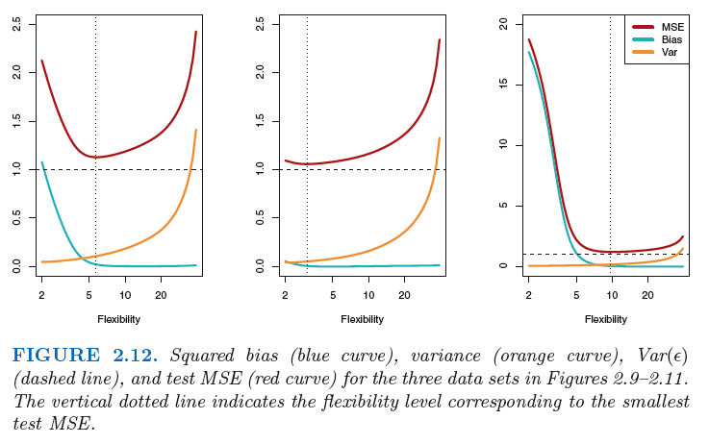
Bias-Variance Trade-off
Notes:
Overfitting happens when a model learns the detail and noise in the training data to the extent that it negatively impacts the performance of the model on new data.
models with a large number of free parameters can describe an amazingly wide range of phenomena and can fit any amount of data available. Even if such a model agrees well with the available data, that doesn’t make it a good model.
Additional insight: https://towardsdatascience.com/deep-learning-overfitting-846bf5b35e24

Slide 32
Bias-Variance Trade-off
Source: Yaser Abu-Mostafa, Learning from Data (the AMLbook).

Slide 33
Bias-Variance Trade-off
Source: Yaser Abu-Mostafa, Learning from Data (the AMLbook).

Slide 34
Bias-Variance Trade-off
Source: Yaser Abu-Mostafa, Learning from Data (the AMLbook).

Slide 35
Bias-Variance Trade-off
Source: Yaser Abu-Mostafa, Learning from Data (the AMLbook).

Slide 36
Bias-Variance Trade-off
Source: Yaser Abu-Mostafa, Learning from Data (the AMLbook).

Slide 37
Bias-Variance Trade-off
Source: Yaser Abu-Mostafa, Learning from Data (the AMLbook).

Slide 38
Bias-Variance Trade-off
Source: Yaser Abu-Mostafa, Learning from Data (the AMLbook).

Slide 39
Bias-Variance Trade-off: Learning Curve
Source: Yaser Abu-Mostafa, Learning from Data (the AMLbook).

Slide 40
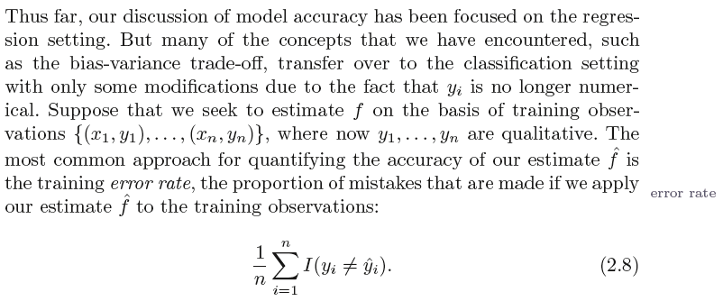
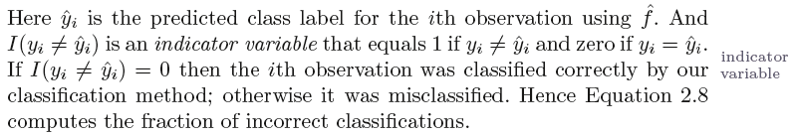
Error in the Classification Setting

Slide 41
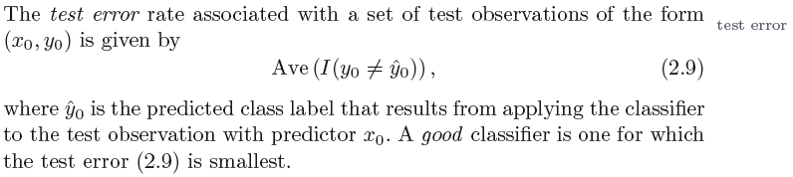
Error in the Classification Setting: Test Error
How would you calculate the test error?

Slide 42
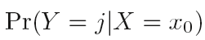
Bayes Classifier
The test error rate given in (Eq. 2.9) is minimized, on average, by a very simple classifier that assigns each observation to the most likely class, given its predictor values. In other words, we should simply assign a test observation with predictor vector x₀ to the class j for which the following probability is the largest:
Note that the Equation above is a conditional probability: it is the probability that Y = j , given the observed predictor vector x₀ . This very simple classifier is called the Bayes classifier .

Slide 43
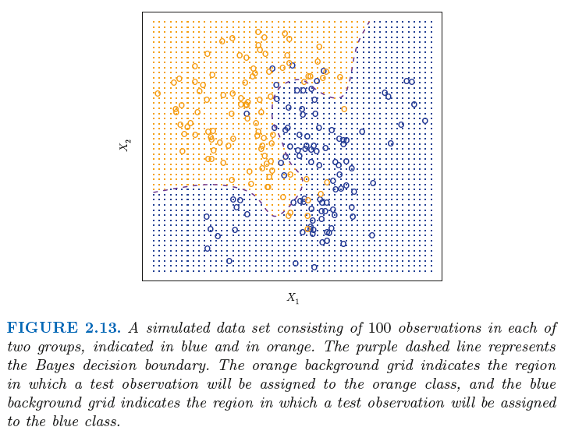
Bayes Classifier: Two-Class Example
Bayes Decision Boundary
Bayes Error Rate:
Test error rate of the Bayes classifier; It is greater than
zero, because the classes overlap in the true population.
Notes:
Bayes error rate: For our simulated data, the Bayes error rate is 0. 1304.

Slide 44
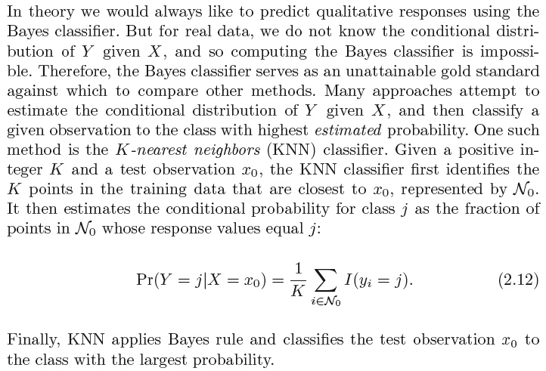
K-Nearest Neighbors (KNN) Classifier

Slide 45
K-Nearest Neighbors (KNN) Classifier

Slide 46
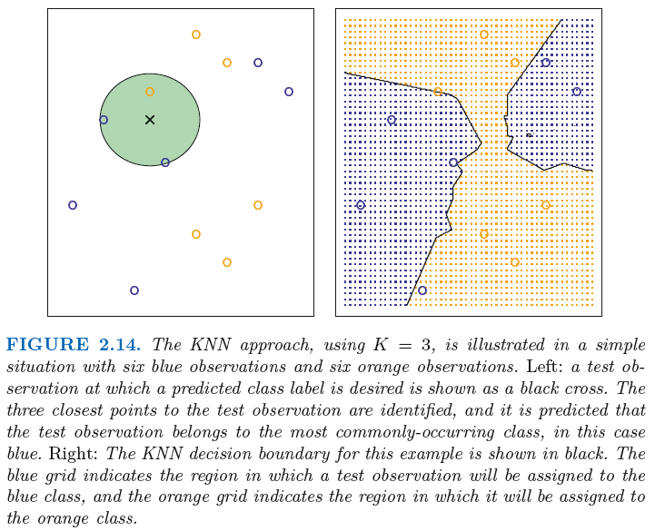
KNN Example

Slide 47
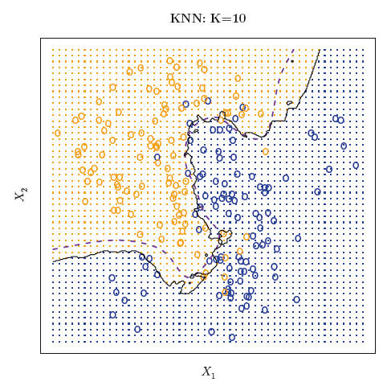
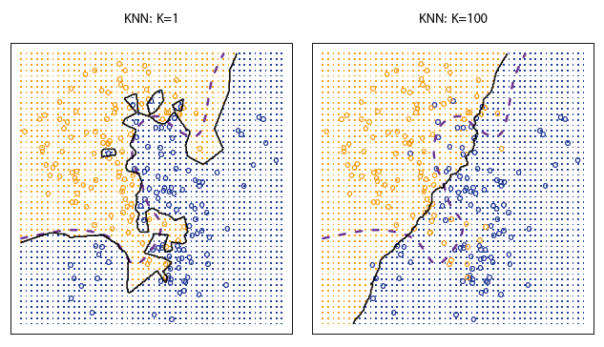
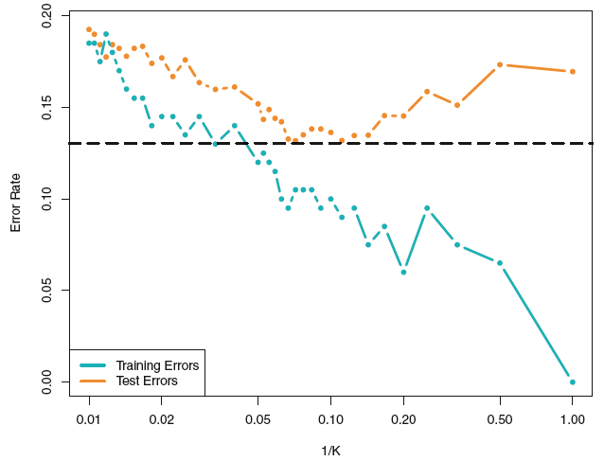
K-Nearest Neighbors (KNN) Classifier

Slide 48
Additional Resources
Bias-Variance tradeoff in KNN
http://scott.fortmann-roe.com/docs/BiasVariance.html
Overfitting
https://towardsdatascience.com/deep-learning-overfitting-846bf5b35e24

Slide 49
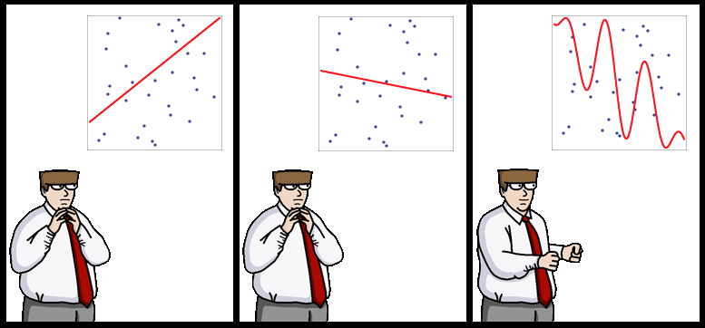
End of Lecture
Source: http://yaroslavvb.blogspot.com/

